Slide 1
Lecturer
Omar A. Imran
2019 - 2020
Microsoft office Excel 2007
Diyala university/College of Engineering
Department of Chemical Engineering
Republic of Iraq
Ministry of Higher
Education
University of Diyala
College of Engineering
Chemical Department
First Class
and scientific Research
Trail Version
Trail Version
Trail Version
Trail Version
Trail Version
Trail Version
Trail Version
Trail Version
Trail Version
Trail Version
Trail Version
Trail Version
Trail Version
First Class
1

Slide 2
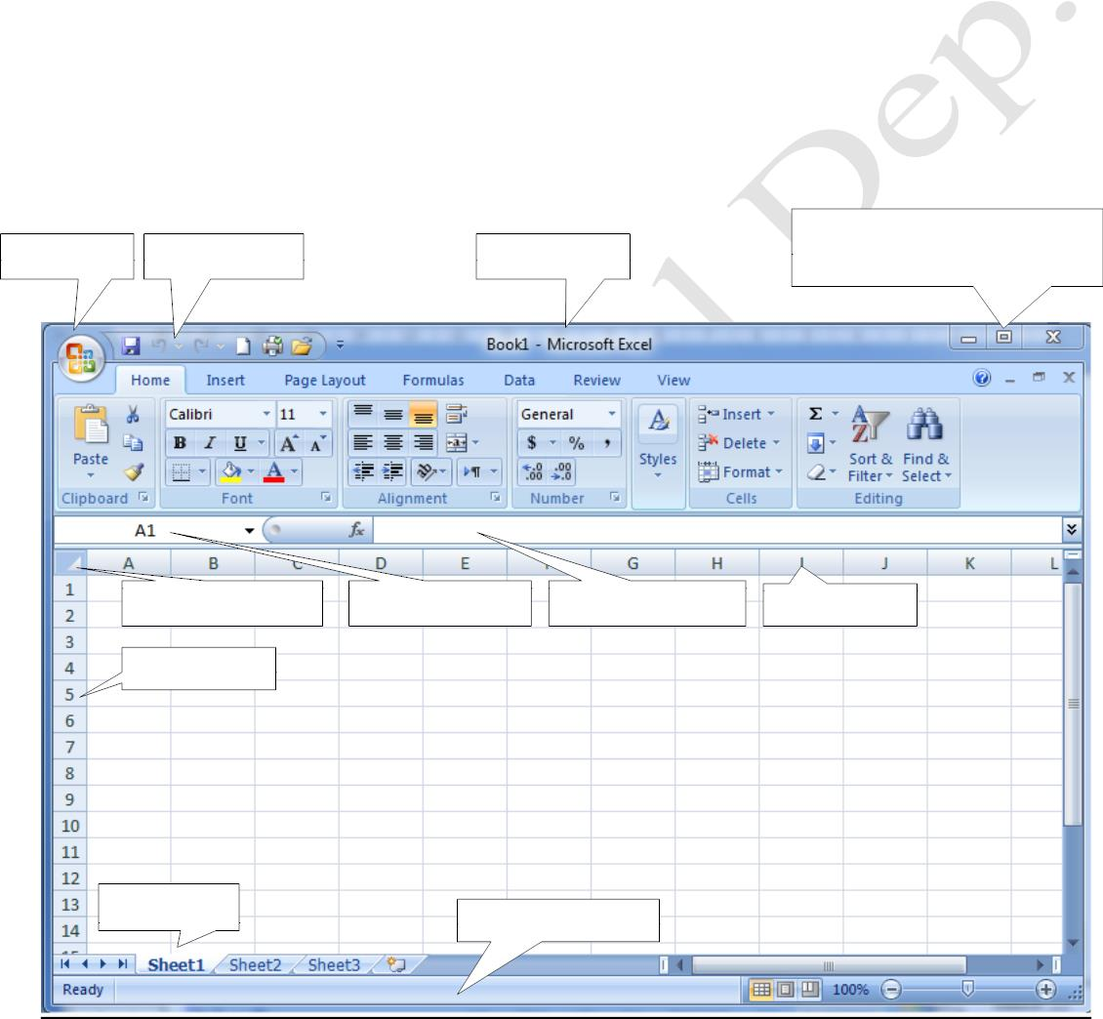
Lecturer
Omar A. Imran
2019 - 2020
Microsoft office Excel 2007
Diyala university/College of Engineering
Department of Chemical Engineering
Introduction
Has been the emergence of the program Excel (spreadsheet) after it called on the need to develop an
environment for tables in Word program, which was necessary a great effort in mobilizing the table
cells after conducting mathematical and logical operations manually before the entry process, and his
appearance was to get rid of operations cumbersome in making the calculations and data entry Per cells
using electronic technology saves time and effort.
How the program is run Excel
Start >> all program >> Microsoft Office >> Microsoft Office Excel 2007
Excel program then begins work
Excel window
When you run the program window appears spreadsheets as specified in below: -
Button office
Rapid toolbar
Address Bar
Buttons zoom in and out of
the program window
Trail Version
Trail Version
Trail Version
Trail Version
Trail Version
Trail Version
Trail Version
Trail Version
Trail Version
Trail Version
Trail Version
Trail Version
Trail Version
Select All button
row
Named box
The formula bar
Column
Worksheet
Information bar
First Class
2

Slide 3
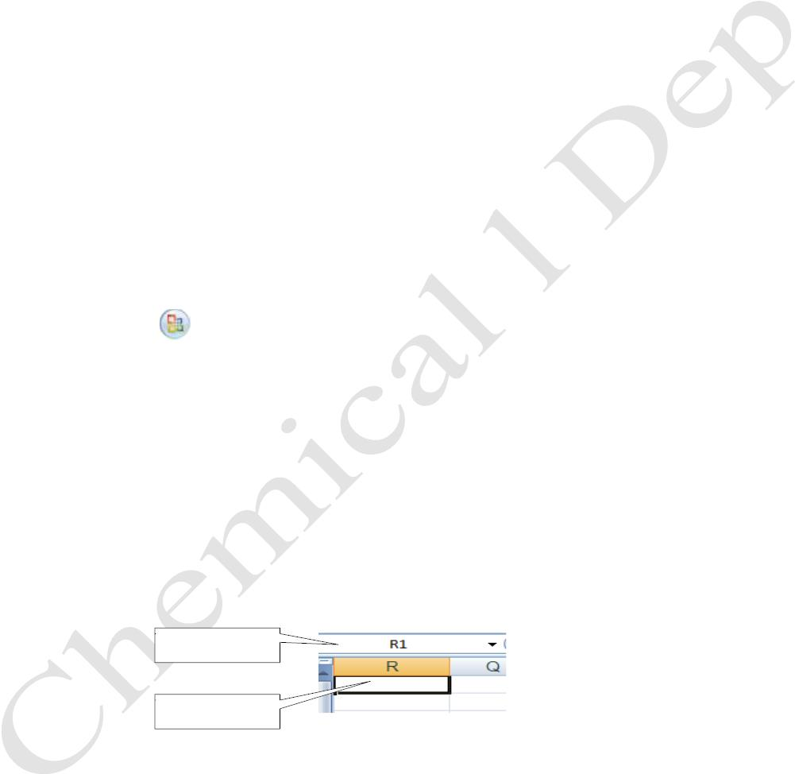
Lecturer
Omar A. Imran
2019 - 2020
Microsoft office Excel 2007
Diyala university/College of Engineering
Department of Chemical Engineering
Outline of the screen
• Address bar : shows the name of the program and the name of the workbook and quick access
bar and logo Office. The buttons ( zooming in and out and closure )
•
•
bar tabs : It contains a set of special collections work program Excel .
groups : a boxes containing a set of command buttons and menus , namely, ( Home , Insert,
Page Layout , Formulas , Data , Review , View ) .
•
formula bar : the rectangle is extended above the columns , and shows the contents of the cell
and its laws , and contains the Name box , and it appears the name of the cell and the symbol
(☑) and (☒) and (fx) the inclusion of the private functions .
•
•
•
seeded or (Book): - seeded consists of three working papers , and the working paper is a single
tables consists of rows and columns
columns : is the upper part of the paper contains a character (A) consists of ( 16384 ) column
column names ranging from the lower (A) until the last column , which (XFD).
rows : be right in the paper and contains a number (1) and consists of ( 1048576 ) row .
• Cells: is a unit of work and is composed of rectangles intersection with rows and columns called
•
•
the name of the column and row . Such as : cell (D7) in column (D) and grade (7) .
bar: at the bottom and contains information in addition to the views and size.
Name box : - that demonstrates the active cell , and it shows the name of the active cell , for
example, A1
Trail Version
Trail Version
Trail Version
Trail Version
Trail Version
Trail Version
Trail Version
Trail Version
Trail Version
Trail Version
Trail Version
Trail Version
•
Trail Version
Office button
excel.
, you can find it in the upper right corner of the programs Microsoft Office
Cell
Is the result of the intersection of the column with the row and each cell a name for Aitakerr with
another cell, for example, the first cell named A1, where A is the symbol of the column and 1 is the
row number and when we press on any cell, the name of the cell will appear in a special fund called
Fund Name box as in the figure below, and be this cell is the active cell. When pressed once on the
cell, it will be to identify a single cell but can select more than one cell at the same time by pressing the
left mouse button and then continue clicking and dragging on a group of cells, but only to be
contiguous when it will be determined a range of cells.
Named box
Active cell
First Class
3

Slide 4
Lecturer
Omar A. Imran
2019 - 2020
Microsoft office Excel 2007
Diyala university/College of Engineering
Department of Chemical Engineering
Range
Is two or more cells in the worksheet. Cells can exceed the range or diverge
Created "Book" New
To create a new workbook, there is more than one way: -
• Choose from logo Office
ordered a new window appears select the blank workbook then
Created.
• From Quick Access Toolbar select a new icon is created blank workbook.
•
clicking on the keys (Ctrl+ N) of the keyboard are Created blank workbook.
Open excel file
To open an existing file in Excel program there is more than one way
• Select Office
of the slogan is to open a dialog box appears, select the location of the file and
•
•
press open.
From Quick Access Toolbar select the Open command select the location of the file and press
open.
by pressing) Ctrl +O) shows the same dialog box, select Open.
Trail Version
Trail Version
Trail Version
Trail Version
Trail Version
Trail Version
Trail Version
Trail Version
Trail Version
Trail Version
Trail Version
Trail Version
Trail Version
Save Excel file
After you create a new workbook and do procedures we can save it for the first time in several ways
as follows: -
•
•
Select Office of the slogan is Remember
From Quick Access toolbar choose code remember
• clicking on the keys (Ctrl +S)
In both cases, a dialog box appears and identify the name and location of the file that document We'll
save him. Then save.
To save the file with the name or in a different format or location different from the Office button
Choose our command "Save As" and follow the same steps as we learned above
Termination Axel Program
Is termination of the program in several ways: -
• Office
of the slogan Choose the Close command.
•
from the address bar, click on the close button.
First Class
4

Slide 5
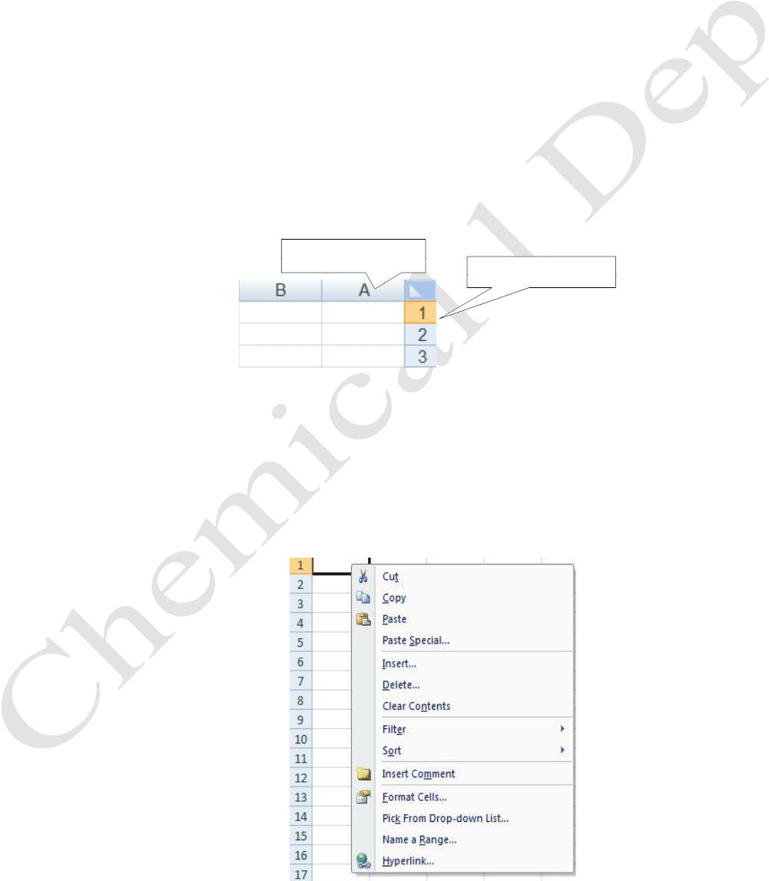
Lecturer
Omar A. Imran
2019 - 2020
Microsoft office Excel 2007
cells
Diyala university/College of Engineering
Department of Chemical Engineering
Dealing
with
If we want to write in any cell, what we only activate the cell and clicking the left mouse button it and
then write directly to the cell via the keyboard required data. If we move to the next cell put pressure
on the key (tab) to take us to one cell to the right or the key (Enter) to take us to the bottom cell. Or of
the shares of the four directions in the keyboard.
• identify cells
• To make the cells must coordinate the onset identify cells that conducting the coordination and
be specifically as follows: -
• to select a cell put pressure on the right- left cell .
• To select a group of adjacent cells , we drag the mouse on a group of cells .
•
to select non-contiguous cells define the first cell , and when we want to identify the second
cell, pressing key (ctrl) with a mouse click and thus define the rest of the cells
• to select the entire column put pressure on the character that represents the column header as
shown in Figure
• to select the entire row put pressure on the figure , which represents the title row as in Figure
• To determine the worksheet push button deviate total , which is located between the intersection
of columns and rows , or from the keyboard , click on the keys CTRL+A.
Column header
Head of the row
Trail Version
Trail Version
Trail Version
Trail Version
Trail Version
Trail Version
Trail Version
Trail Version
Trail Version
Trail Version
Trail Version
Trail Version
Trail Version
• modify the contents of the cell
If we want to modify the contents of the cell must put the cell in the case of editing so that we can
amendment to its contents by clicking the double on the cell and then correct and modify what we want
and you can road second, which make it in the case of editing is a single click in the formula bar and
Then modification or editing from within the formula bar.
When you right Yemen on any cell in the worksheet show the shortcut menu, described as follows.
First Class
5

